Slide 1

INTRODUCTION TO PYTHON
By : DILIP KUMAR

Slide 2
INTRODUCTION :
Python is a high-level, interpreted scripting language developed in the late 1980s by Guido van Rossum at the National Research Institute for Mathematics and Computer Science in the Netherlands. The initial version was published at the alt.sources newsgroup in 1991, and version 1.0 was released in 1994.

Slide 3
The name Python, by the way, derives not from the snake, but from the British comedy troupe Monty Python’s Flying Circus, of which Guido was, and presumably still is, a fan. It is common to find references to Monty Python sketches and movies scattered throughout the Python documentation.

Slide 4
Python History
late 1980s
Python laid its foundation in the late 1980s.
Dec. 1989
The implementation of Python was started in the December 1989 by Guido Van Rossum at CWI in Netherland.
Feb. 1991
In February 1991, van Rossum published the code (labeled version 0.9.0) to alt.sources.
1994
In 1994, Python 1.0 was released with new features like: lambda, map, filter, and reduce.
3 Dec. 2008
On December 3, 2008, Python 3.0 (also called "Py3K") was released. It was designed to rectify fundamental flaw of the language.

Slide 5

ABC programming language is said to be the predecessor of Python language which was capable of Exception Handling and interfacing with Amoeba Operating System.
Python is influenced by following programming languages:
ABC language.
Modula-3

Slide 6
Why Choose Python?
Python is Popular
Python is Interpreted
Python is Free
Python is Simple

Slide 7
Who uses python
Face book
Google
Intel
Some of them uses it for development
And some for testing
And some to test their sample data

Slide 8
Python Features
Easy to Learn and Use
Expressive Language
Interpreted Language
Cross-platform Language
Free and Open Source
Object-Oriented Language
Extensible
Large Standard Library
GUI Programming Support
Integrated

Slide 9
Python Application Areas
Web Application
Desktop GUI Application
Software Development
Scientific & Numeric
Business Application
Console Based Applications
Audio or Video based Applications
3D CAD Applications
Enterprise Applications
Application for Images

Slide 10
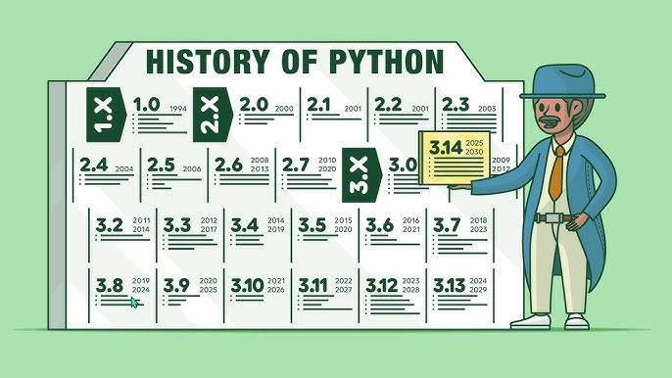

Slide 11
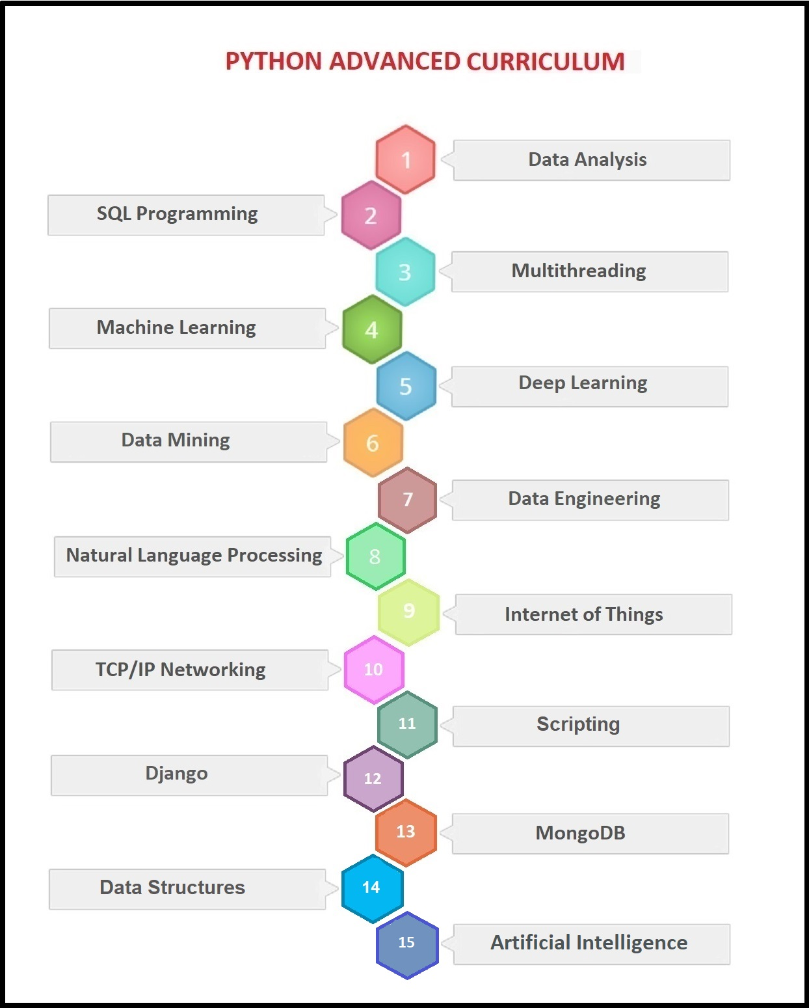

Slide 12
Python Example
Python is easy to learn and code and can be executed with python interpreter. We can also use Python interactive shell to test python code immediately.
A simple hello world example is given below. Write below code in a file and save with .py extension. Python source file has .py extension.
Ex: print("hello world by python!")

Slide 13
Python Example using Interactive Shell
Python interactive shell is used to test the code immediately and does not require to write and save code in file.
Python code is simple and easy to run. Here is a simple Python code that will print "Welcome to Python".
Ex:- >>> a="Welcome To Python"
>>> print (a)
Welcome To Python
>>>

Slide 14
Python Variables
Variable is a name which is used to refer memory location. Variable also known as identifier and used to hold value.
In Python, we don't need to specify the type of variable because Python is a type infer language and smart enough to get variable type.
Variable names can be a group of both letters and digits, but they have to begin with a letter or an underscore.

Slide 15
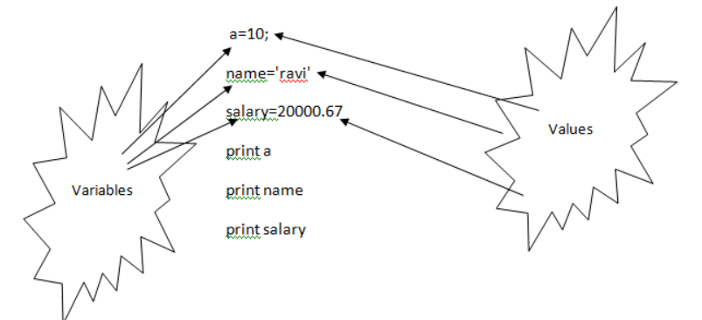
Declaring Variable and Assigning Values
Python does not bound us to declare variable before using in the application. It allows us to create variable at required time.
We don't need to declare explicitly variable in Python. When we assign any value to the variable that variable is declared automatically.
The equal (=) operator is used to assign value to a variable.

Slide 16
Multiple Assignment
Python allows us to assign a value to multiple variables in a single statement which is also known as multiple assignment.
1. Assigning single value to multiple variables
Ex:- x=y=z=50
2.Assigning multiple values to multiple variables:
Ex:- a,b,c=5,10,15

Slide 17
Basic Fundamentals:
i)Tokens and their types.
ii) Comments
a)Tokens:
Tokens can be defined as a punctuator mark, reserved words and each individual word in a statement.
Token is the smallest unit inside the given program.
There are following tokens in Python:
Keywords.
Identifiers.
Literals.
Operators.

Slide 18
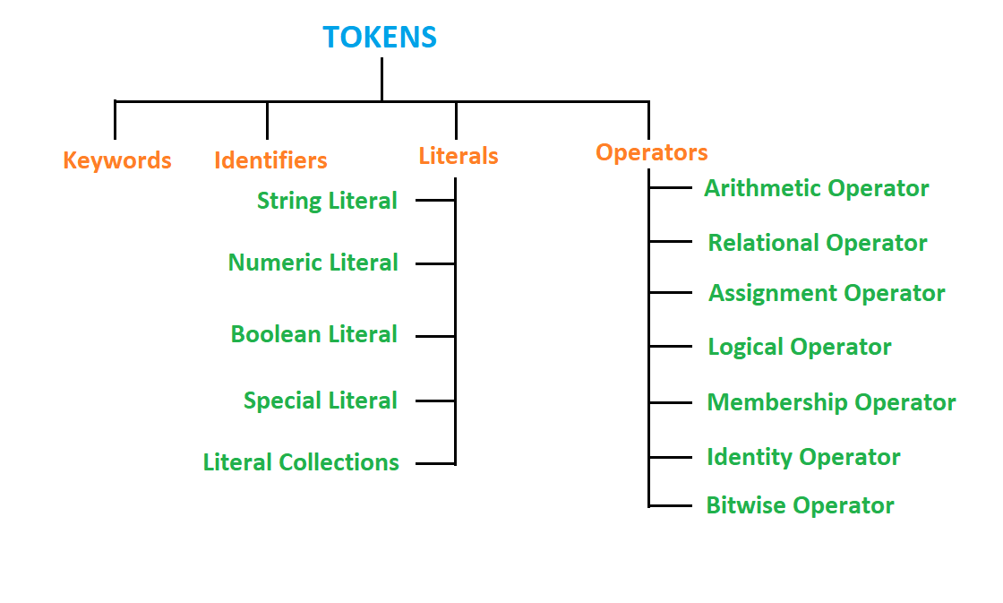

Slide 19
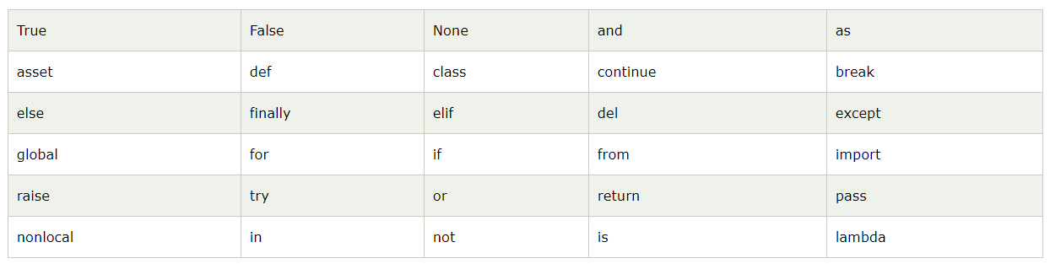
Python Keywords
Python Keywords are special reserved words which convey a special meaning to the compiler/interpreter. Each keyword have a special meaning and a specific operation. These keywords can't be used as variable

Slide 20
Identifiers
Identifiers are the names given to the fundamental building blocks in a program.
These can be variables ,class ,object ,functions , lists , dictionaries etc.
There are certain rules defined for naming i.e., Identifiers.
I. An identifier is a long sequence of characters and numbers.
II.No special character except underscore ( _ ) can be used as an identifier.
III.Keyword should not be used as an identifier name.
IV.Python is case sensitive. So using case is significant.
V.First character of an identifier can be character, underscore ( _ ) but not digit.

Slide 21
Python Literals
String literals
Numeric literals
Boolean literals
Special literals
Literal Collections

Slide 22
Python Operators
Types of Operators
Arithmetic Operators.
Relational Operators.
Assignment Operators.
Logical Operators.
Membership Operators.
Identity Operators.
Bitwise Operators.

Slide 23
Python Comments
1) Single lined comment:
#print(“hai”)
2) Multi lined Comment:
‘’’print(“hai”)
Print(“hello”)’’’

Slide 24
Control Statements
If If _else
For else _if
While Nested _if
Break
Continue
Pass

Slide 25
Data Structures
Def : It is a type of container which stores the different datatype values.
1. String = ‘ ‘
2. List = [ ]
3. Tuple = ( )
4.Dictionary = {K:V}
5. Sets = {} or set[( )]

Slide 26
Mutable Vs Immutable
In Python everything is an object. An object mutability is determined by its type. Some of these objects like LISTS & DICTIONARIES are mutable, meaning you can change their content without changing their identity.
Other objects like INTEGERS, FLOATS, STRINGS & TUPLES are objects that cannot be changed.

Slide 27
Python handles mutable & immutable objects differently . Immutable are quicker to access than mutable object. Also, immutable object are fundamentally expensive to “change”, because doing so involves creating a copy. Changing mutable object is cheap.
Concatenating string in loops waste lots of memory , because strings are immutable, concatenating two strings together actually creates a third string which is the combination of the previous two. Use list compression join technique.

Slide 28
1. Strings : ‘ ‘
Python string is a built-in type text sequence. It is used to handle textual data in python. Python Strings are immutable sequences of Unicode points. Creating Strings are simplest and easy to use in Python.
Accessing Python Strings :
In Python, Strings are stored as individual characters in a contiguous memory location.
The benefit of using String is that it can be accessed from both the directions (forward and backward).
Both forward as well as backward indexing are provided using Strings in Python.
Forward indexing starts with 0,1,2,3,....
Backward indexing starts with -1,-2,-3,-4,....

Slide 29
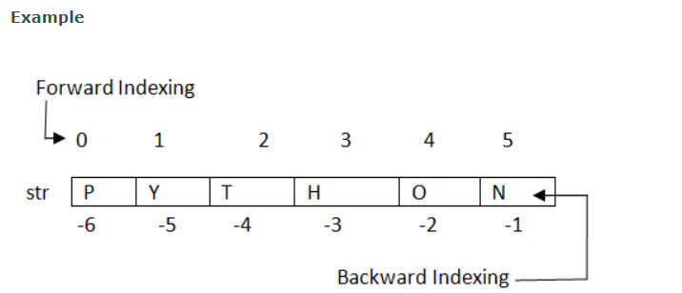
Python Strings Operators:
1.Basic Operators. (Concatenation, Replication)
2.Membership Operators.(In , Not In)
3.Relational Operators. (<,><=,>=,==,!=,<>)
Python String Slice Notation :
Python String slice can be defined as a substring which is the part of the string. Therefore further substring can be obtained from a string
Syntax :
<string_name>[startIndex:endIndex],
<string_name>[:endIndex],
<string_name>[startIndex:]

Slide 30
Python String endswith(string) Method Example
string1="Welcome to PYTHON";
substring1=“PYTHON";
substring2="to";
substring3="of";
print string1.endswith(substring1);
print string1.endswith(substring2,2,16);
print string1.endswith(substring3,2,19);
print string1.endswith(substring3);

Slide 31
2. Python List : [ ]
Python list is a data structure which is used to store various types of data.
In Python, lists are mutable i.e., Python will not create a new list if we modify an element of the list.
It works as a container that holds other objects in a given order. We can perform various operations like insertion and deletion on list.
A list can be composed by storing a sequence of different type of values separated by commas.

Slide 32
continue…..
Accessing List (slicing operation)
List Operations:
1. Replication
2. Adding
3. Other Operations( updating, appending,deleting)
List methods: min(),max(),len(),cmp(list1,list2),
list(sequence)

Slide 33
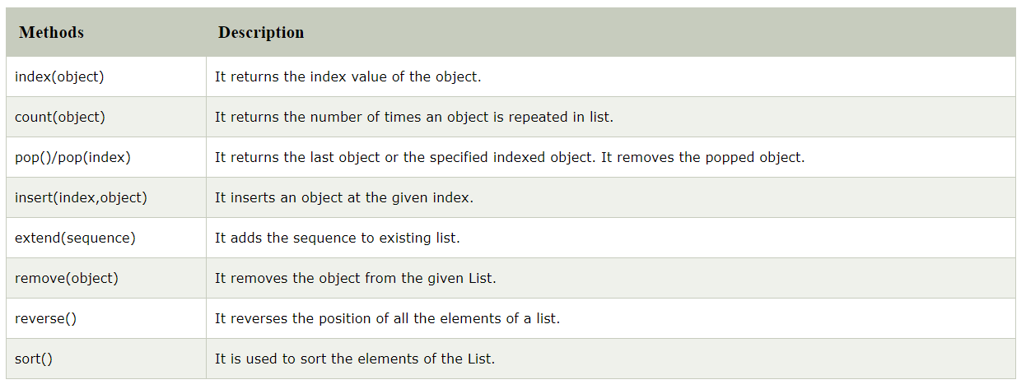
Built_in_methods of List:

Slide 34
3. Python Tuples : ( )
A tuple is a sequence of immutable objects, therefore tuple cannot be changed. It can be used to collect different types of object.
The objects are enclosed within parenthesis and separated by comma.
Tuple is similar to list. Only the difference is that list is enclosed between square bracket, tuple between parenthesis and List has mutable objects whereas Tuple has immutable objects.

Slide 35
Advantages of Tuple
Processing of Tuples are faster than Lists.
It makes the data safe as Tuples are immutable and hence cannot be changed.
Tuples are used for String formatting.

Slide 36
Contuinue….
Empty tuple: tuple1=( )
Single Object Tuple : x=(10,)
Tuple Operations: Addition, Replication, Slicing
Other operations: Updating, creating, Deleting
Function of tuple: min(),max(),len(),cmp(tuple1, tuple2), tuple(sequence)

Slide 37
4. Dictionary : {K:V}
Dictionary is an unordered set of key and value pair. It is a container that contains data, enclosed within curly braces.
The pair i.e., key and value is known as item. The key passed in the item must be unique.
The key and the value is separated by a colon(:). This pair is known as item. Items are separated from each other by a comma(,). Different items are enclosed within a curly brace and this forms Dictionary.

Slide 38
Continue…
Accessing Dictionary Values
Updating Python Dictionary Elements
Deleting Python Dictionary Elements
Python Dictionary Functions: len( ), cmp(dic1,dic2), str(dict)

Slide 39
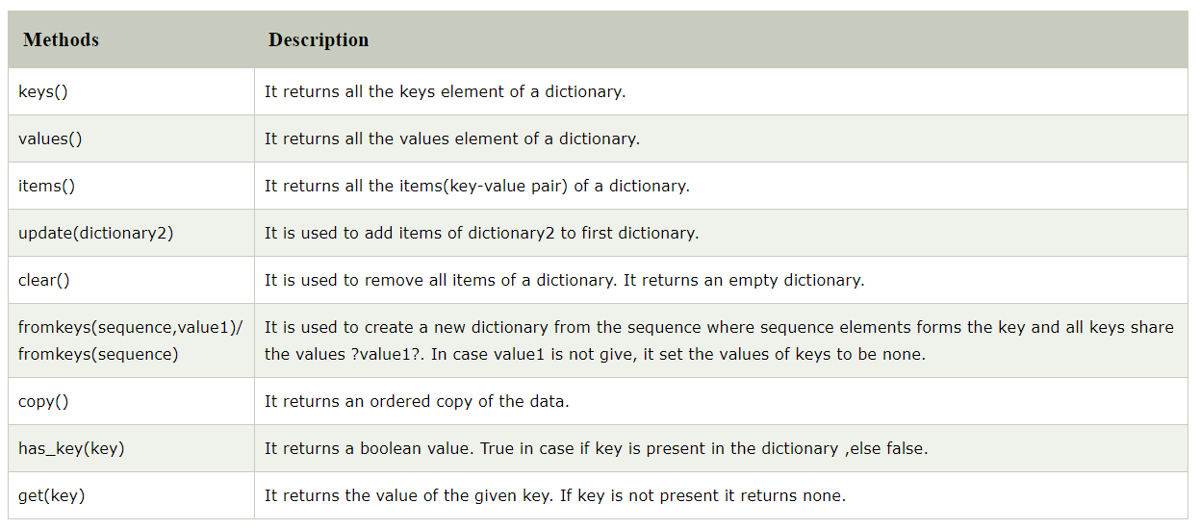
Dictionary Methods

Slide 40
Python Functions
A Function is a self block of code which is used to organize the functional code.
Function can be called as a section of a program that is written once and can be executed whenever required in the program, thus making code reusability.
Types of Functions:
a) Built-in Functions
b) User- Defined

Slide 41
Defining a Function A Function defined in Python should follow the following format:
1) Keyword def is used to start and declare a function. Def specifies the starting of function block.
2) def is followed by function-name followed by parenthesis.
3) Parameters are passed inside the parenthesis. At the end a colon is marked.
Python Function Syntax:
def <function_name>(parameters):
</function_name>
4) Python code requires indentation (space) of code to keep it associate to the declared block.
5) The first statement of the function is optional. It is ?Documentation string? of function.
6) Following is the statement to be executed.

Slide 42
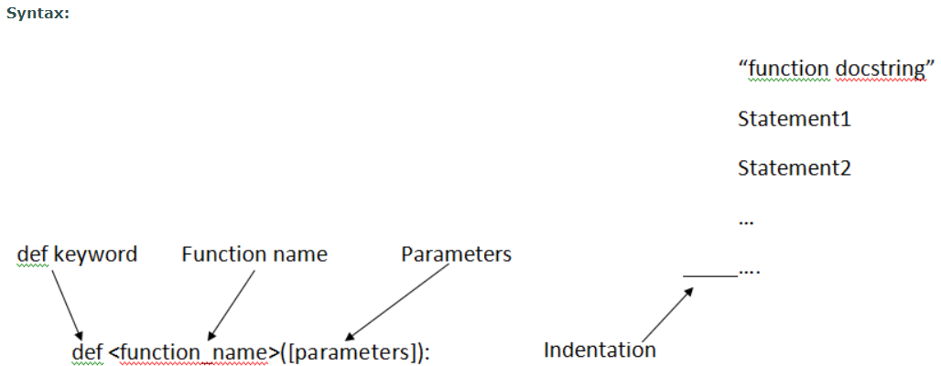
Python Function Syntax

Slide 43
Documenting a function
If you introspect the function, you will find a few hidden methods (starting with 2 underscores) amongst which the __doc__, that is used to set the documentation of a function. Python documentation are called docstring and can be put together with a function
Syntax:
def <function_name>():
‘’’ enter the string that you want to document’’’
<function_name>.__doc__

Slide 44
Recursive functions
Recursion is not a Python property, it is a common technique in computer science where a function calls itself. The most common example is the factorial computation n! = n * n-1 * n-2 * ... 2 * 1. Knowing that 0! = 1, the factorial function .
Syntax: def <function_name>():
<statement>
return <function_name>

Slide 45
Specifying an arbitrary number of arguments
1. Positional arguments
The way Python handle the provided arguments is to match the normal positional arguments from left to right and then places any other positional arguments in a tuple (*args) that can be used by the function.
Syntax: def func(pos_params, *args):
block statememt
func(pos_params, arg1, arg2, ...)

Slide 46
2. Arbitrary number of keyword arguments
The way Python handles the provided keyword arguments is to match the normal positional arguments from left to right and then places any other positional arguments in a tuple (*args) that can be used by the function (sse previous section) and finally places any excess of keyword arguments in a dictionary (**kwargs) that can be used by the function.
Syntax : def func(pos_params, *args, **kwargs):
block statememt
func(pos_params, kw1=arg1, kw2=arg2, ...)

Slide 47
Lambda Function
Lambda function are short one-line functions that have no name. They can contain only one statement so for instance the if, for and while are not allowed. They can be assigned to a variable (not compulsary)
In Python, lambda function can be used to replace a simple function. This lambda function is called an anonymousfunction because they have no name.
Syntax: <var>=lambda <par1><par2>:<operation>

Slide 48
Zip Function
The zip() function takes one or more sequences as arguments and returns a list of tuples.
The ith tuple contains the ith values of each sequence.
If the input sequences do not have the same length, the list is truncated to the length of the shortest sequence.
This function is often used to loop over several sequences
Syntax : for x,y in zip([1,2,3], [-1,-2,-3]):
print x+y

Slide 49
Reduce Fucntion
The reduce() function is not very common but could be useful. It applies a function of two arguments cumulatively to the items of a sequence
Ex : reduce(lambda x, y: x*y, [1,2,3,4,5]

Slide 50
List Comprehension
In Python, there is a special syntax called list comprehension that allows to write loops in a very simple and intuitive way.

Slide 51
Filter & Map Function
Filter Function: The filter() function is often used with the lambda function.It returns the items of the sequence for which function(item) is true. For instance the following lambda function returns True if x is even.
Syntax : filter(function, sequence)
Ex: f = lambda x: x%2 == 0
filter(f, [0,3,6,9])

Slide 52
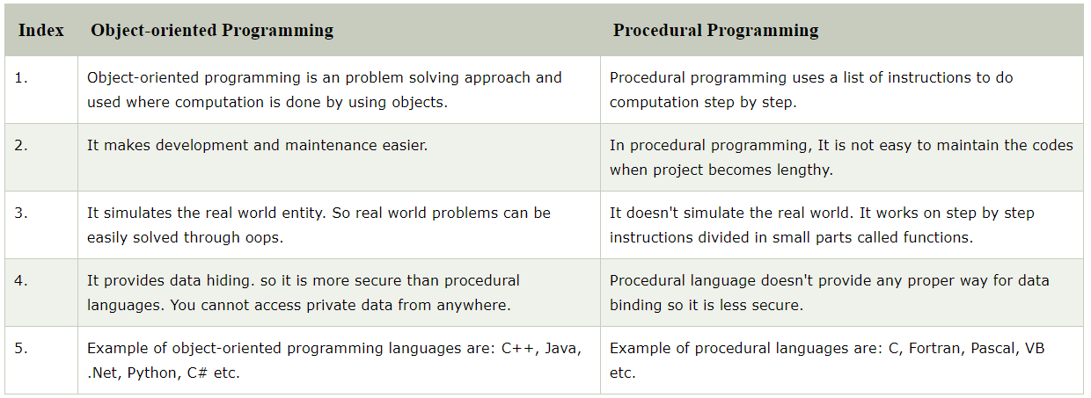
Object-oriented vs Procedure-oriented Programming languages

Slide 53
OOPS-Concepts
Class : Collection of Objects. It is a logical entity that has some specific attributes and methods
Object : Blue print of a class (or) Instance of a class.
Method : It is a type of function that is associated with an object.
Inheritance : Extracting some properties (or) features from base class(parent) to derived class(child).

Slide 54
Continue……………
Polymorphism : Polymorphism is by two words "poly" and "morphs". Poly means many and Morphs means form, shape.
Encapsulation : Wrapping (grouping) up of data into a single unit.
Data Abstraction : Data abstraction and encapsulation both are often used as synonyms. Both are nearly synonym because data abstraction is achieved through encapsulation.
Abstraction is used to hide internal details and show only functionalities

Slide 55
Constructor
DEF : It is a special member function which is used to initialise the objects of its class.
Creating a Constructor:
A constructor is a class function that begins with double underscore (_). The name of the constructor is always the same __init__().
While creating an object, a constructor can accept arguments if necessary. When we create a class without a constructor, Python automatically creates a default constructor that doesn't do anything.
Every class must have a constructor, even if it simply relies on the default constructor.

Slide 56
Types of constructor
1. Parameterised constructor
2. Non- Parameterised Constructor
3. Default Constructor
Self : self represents the instance of the class.
By using the "self" keyword we can access the attributes and methods of the class in python.

Slide 57
Destructor
Destructor is also a special member function which is used to destroy the already created constructor.
Destructors are called when an object gets destroyed.
These methods are only called on creation and destruction of the object. They are not called manually but completely automatic.

Slide 58
OOPS :- Inheritance
The child class or derived class inherits the features from the parent class, adding new features to it. It facilitates re-usability of code.
TYPES :
Single Inheritance
Multilevel Inheritance
Multiple Inheritance
Hierarchical Inheritance
Hybrid Inheritance

Slide 59
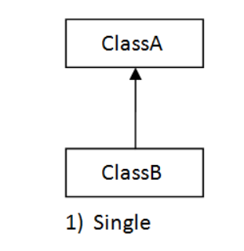
1. Single Inheritance

Slide 60
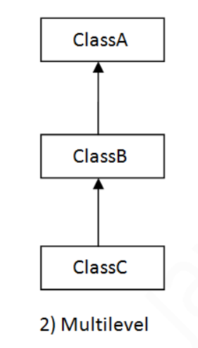
2. Multilevel Inheritance

Slide 61
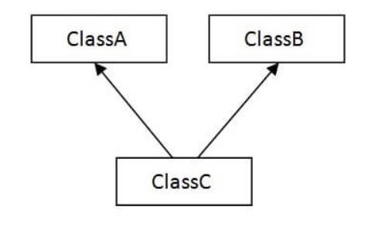
3.Multiple Inheritance

Slide 62
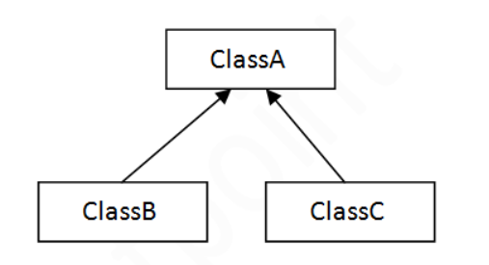
4. Hierarchical Inheritance

Slide 63
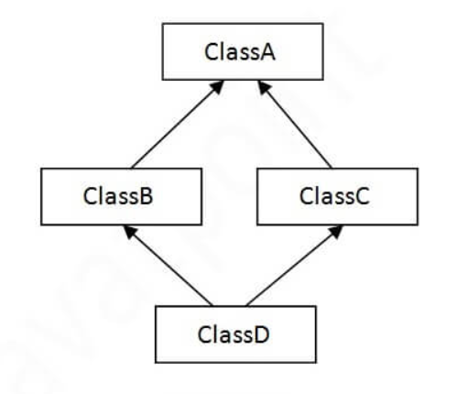
5. Hybrid Inheritance

Slide 64
Polymorphism
Polymorphism is the ability to leverage the same interface for different underlying forms such as data types or classes. ... Polymorphism allows for flexibility and loose coupling so that code can be extended and easily maintained over time.
Types :
Compile time Polymorphism (Method Overloading)
Run time polymorphism (Method Overriding)

Slide 65
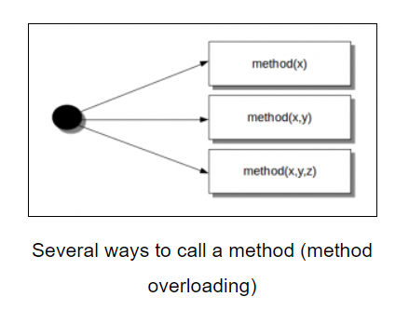
Method Over loading :
Def : Same name with different parameter;

Slide 66
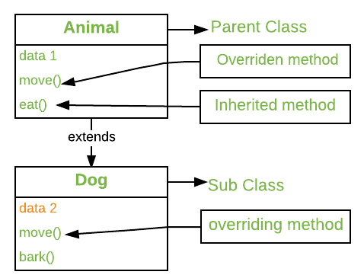
Method over riding :
Def : Same name with same parameters

Slide 67
Encapsulation :
In an object oriented python program, you can restrict access to methods and variables. This can prevent the data from being modified by accident and is known as encapsulation

Slide 68
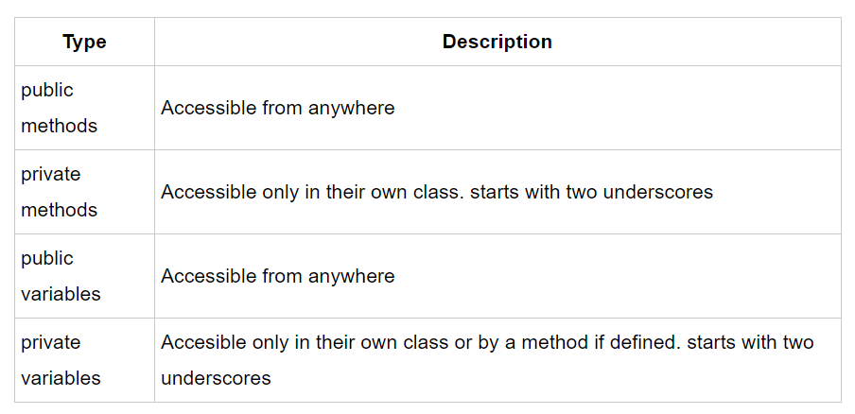
Types of Encapsulation

Slide 69
Data Abstraction
We can say that object-oriented programming relies heavily on encapsulation. The terms encapsulation and abstraction (also data hiding) are often used as synonyms. They are nearly synonymous, i.e. abstraction is achieved through encapsulation

Slide 70
Data Structures
Def : It is a type of container which stores the different datatype values.
1. String = ‘ ‘
2. List = [ ]
3. Tuple = ( )
4.Dictionary = {K:V}
5. Sets = {} or set[( )]

